Slide 1

Ames, Iowa Housing Data Analysis
By: Daniel Immediato
Date: 5/03/24
Notes:
The third project was designated based on Kaggle’s Competition on the Ames, Iowa dataset focusing on predictive insights and machine learning.

Slide 2
Preliminary: What is the Ames Dataset?
Ames, Iowa is a college town of Iowa State University. The Ames dataset consists of the housing sale records between 2006-2010, including features like their attributes and sale prices. The goal of this project was twofold:
Provide a data analysis of the included features.
This includes descriptive models of key features (such as linear and lasso regressions). The highlight being to find the strongest correlations and those values with highest statistical significance.
Develop machine learning algorithms for the sale prices.
This includes multiple linear regression, random forest, and gradient boosting. The focus would be on high accuracy and high variance (R Squared).
Ideally, one would find the most significant contributing factors using multiple linear regression, then one would find the most important indicators using random forest.
Notes:
Basically, the goal was to mold the data into a workable state, create machine learning algorithms based on that data, refine the algorithms as needed, and then provide an analysis of the results. The target of the project as a whole was sale price, where we wanted to see which factors influenced sale price the most, both in regards to feature importance (which can be done through a random forest model and gradient boosting) and correlation strength/significance (which can be done through a multiple linear regression model).

Slide 3
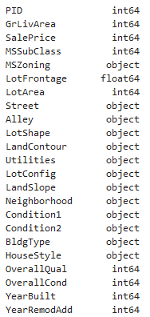
Modifying the Data: Data Types
Before beginning any sort of analysis, one must examine whether or not the data “can” be anyalyzed properly to begin with. The typical dataset is split between numeric and categorical values. When coding, one has to ensure values are consistently classified throughout.
As a few examples, taken plainly, YearBuilt and YearRemodAdd are both dates and not integers. We also know PID (a classification) is a string, not an integer. MSSubClass is also a category, not an integer.
It is necessary to convert these to their proper data types, otherwise errors may occur or results may appear different than expected.
Notes:
The Ames dataset has multiple data types, with the majority being divided between categorical (string) and numeric (integer and float). When dealing with so many variables, it’s advised to properly assign the data types, otherwise preforming an analysis might not even work to begin with. As an example here, we know MSSubClass is a category, not an integer. This is important for labelencoding. I opted to convert the files to pkles for easier transfer from python file to python, which preserves data type integrity.

Slide 4
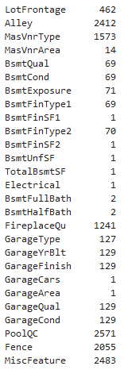
Modifying the Data: Nulls and NA
An NA value is likely to cause the most issues when dealing with data. When running functions, depending on the program, many can’t process them and may produce an error or show results incorrectly. To deal with them you have several options, such as:
Assume what the value was going to be based on related values.
Replace values as a “0” or “none” if the value is legitimately lacking, or if there is no value.
Replace values with most common value or median.
Shown is an untransformed version of the “count” of all missing values in the dataset.
Notes:
Another preliminary to take into note is the amount of NA and Null values in your data. These can also lead to errors if they remain. One can drop the rows containing them, replace them with “none” or “0”, or replace them with the mean, median, or most likely value.

Slide 5
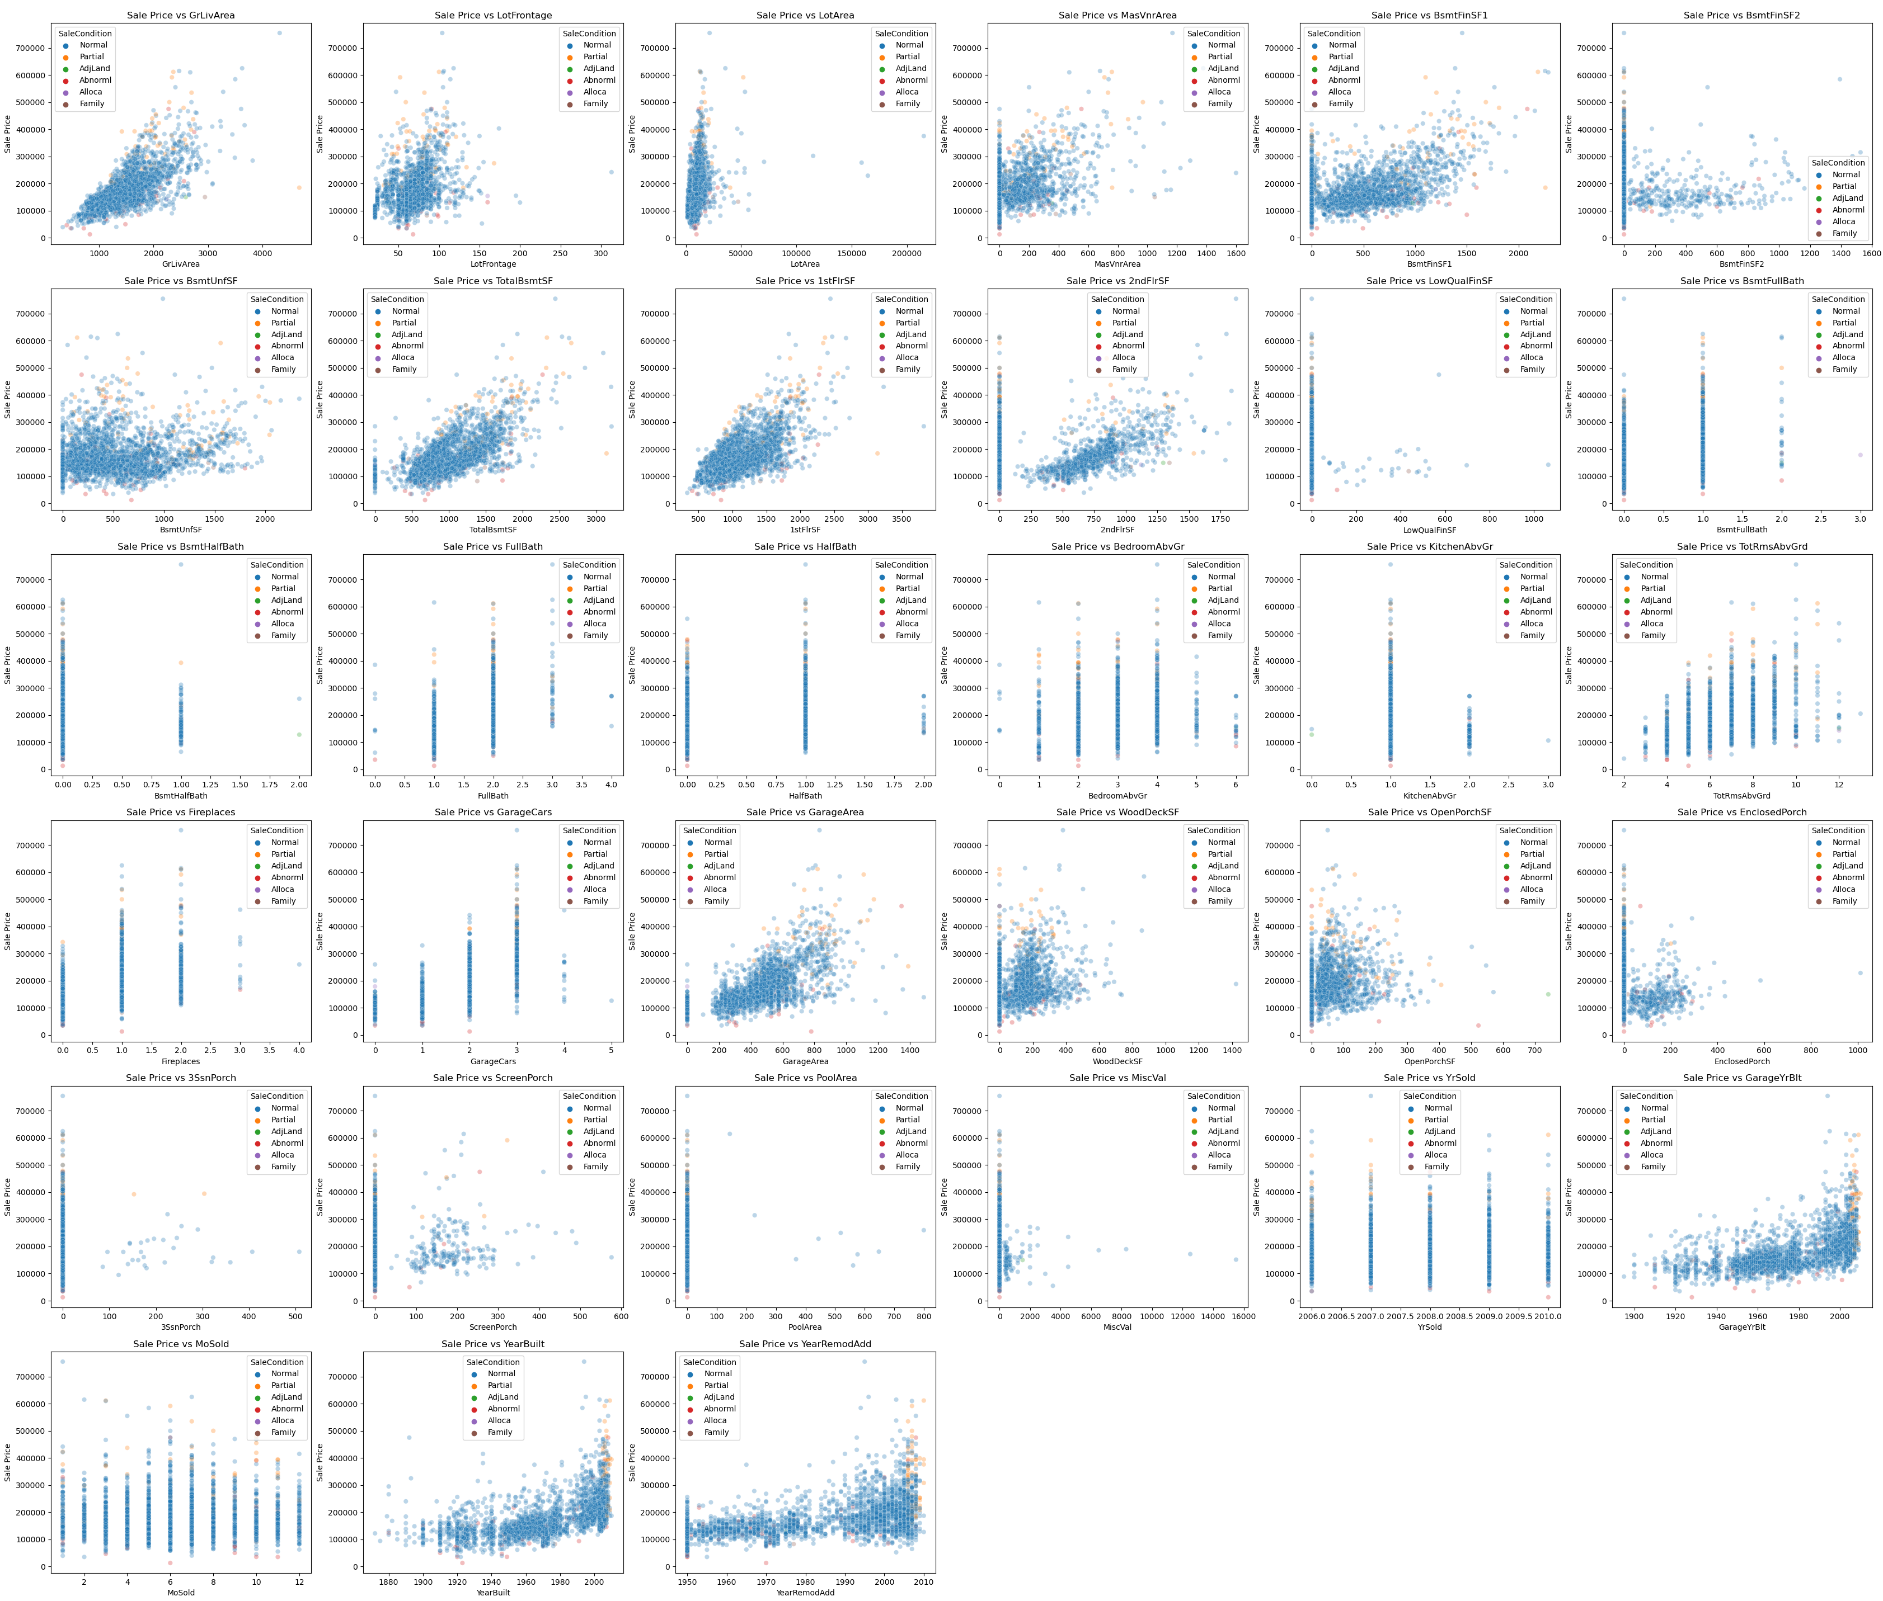
Overview: Numeric
Here is every numeric variable tested against the target, which is SalePrice. We can see many of the variables have some sort of correlation just from eyeing them, and we can also tell which might satisfy the features of linear regression.
We can also see which variables are ordinal judging by the spacing of the plot points.
However, having so much data displayed like this is not very helpful.
Notes:
Here we see a summary of the numeric features plotted against the target. As an overview, many of them seem to have a basic positive trend (just for example the first one top left, above ground living area, appears to coincide with linearity). Noticeable are also the variables that are ordinal, where several still maintain that positive trend, such as size of garage in car capacity (2nd column, 4th row).

Slide 6
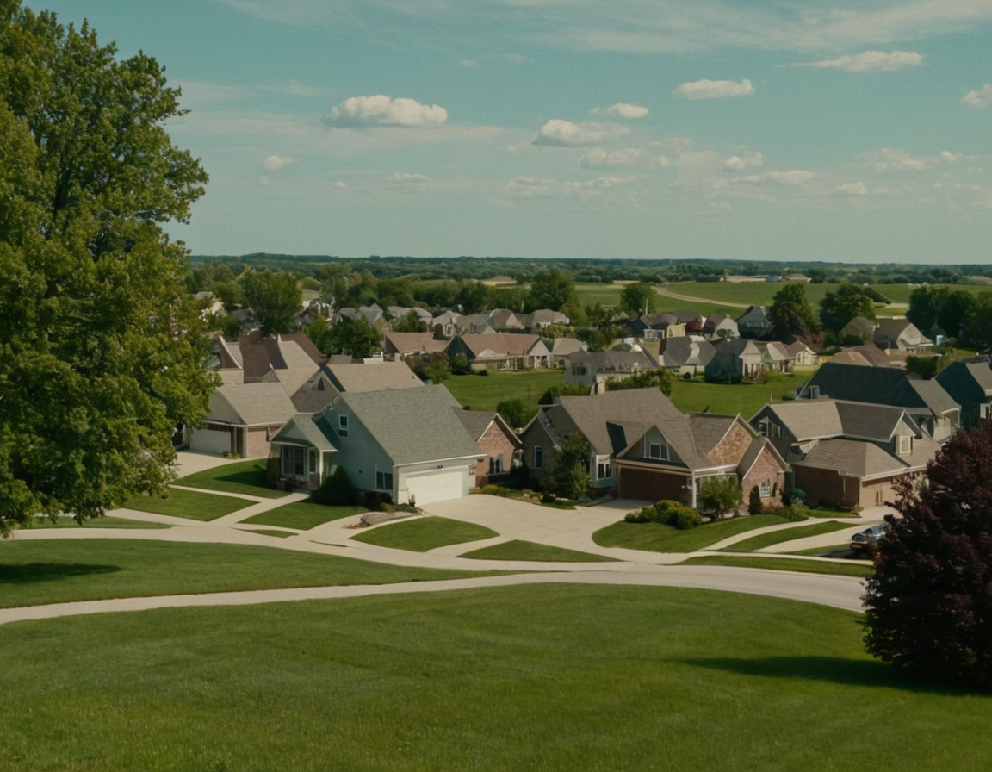
Multiple Linear Regression: As a Model
A MLR is used to determine the strength of relationships, as well as statistical significance. This type of model can help us find the more important variables when compared to our target.
One must ensure features are linear to the target, there is constant variance, normality of errors, there is independence of errors, and that there is as little multi-collinearity as possible.
(Image Created Via Stable Diffusion)
Notes:
The previous overview showed what a MLR could analyze. As a model, regressions determine the strength of relationships between variables, as well as the statistical significance. MLR is unique in that it can be subject to multi-collinearity, where the more and more features that are added, the increasing likelihood that said features are going to influence each other and the outcome.

Slide 7
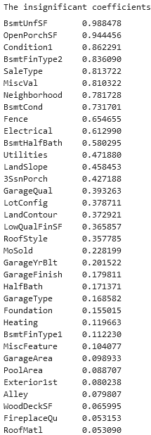
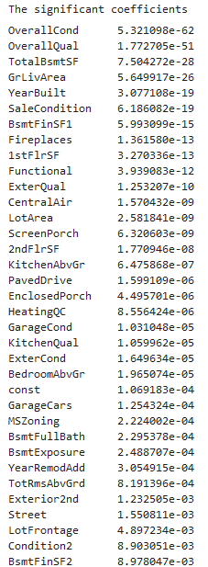
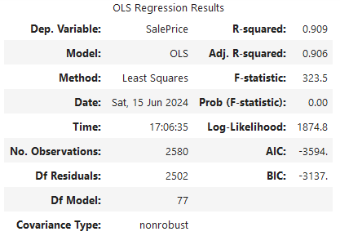
MLR: Default
Since there wasn’t a starting point, we ran a model on all columns (with some modifications). The score was surprisingly high at .91. However, this is unlikely to be helpful considering how much this model suffers from multi-collinearity.
Still, this gives us a basis on where to refine the data based on the significant coefficients.
Notes:
With SalePrice being used as the target, a MLR was created. Here, the model claims that the most significant variables are the overall condition and quality, total basement square footage, above ground living area, and year built. The most insignificant variables were unfinished square feet of basement, open porch square feet, and condition proximity. This model’s R^2 was also .9, which, while not the highest, does have some credence to its predictive accuracy.

Slide 8
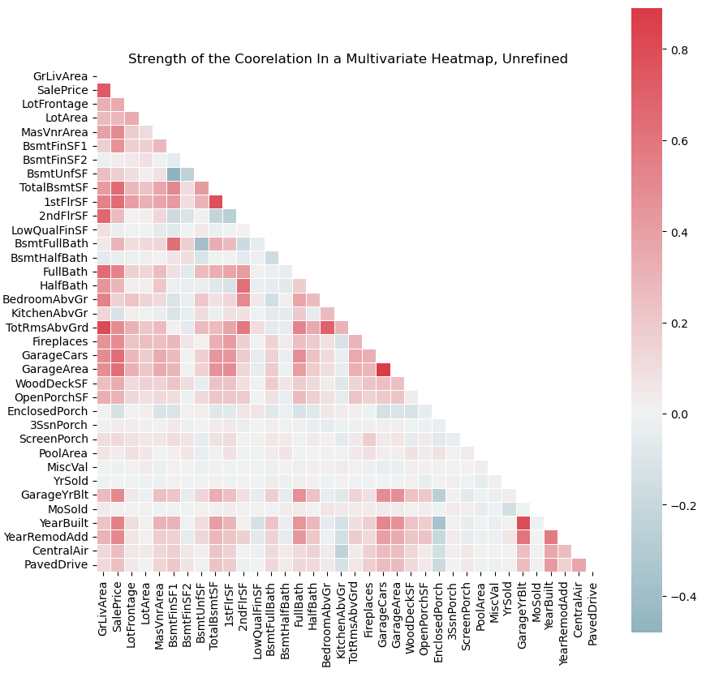
MLR: Summarizing Unrefined Results
To the left, we see the correlations of what the previous MLR told us. Here, it only tells us the numeric correlations, which is why the most significant result, Overall Condition, is not found.
For example, from the heat map, we can see that Ground Living Area is not only very statistically significant (MLR model said 5.64x10^-26), it also is strongly correlated with many other variables, including SalePrice.
Enclosed Porch is another note here, as it is clearly not very correlated with anything, but it was marked as highly statistically significant (4.5x10^-6).
Notes:
Here shows the correlations of what the MLR model told us, focusing only on the numeric results. We can see that just because something is highly correlated, doesn’t mean that it is statistically significant. For example, the model told us that TotalBsmtSF was the most significant numeric value, yet GrLivArea is the most highly correlated variable with our target. Another note is the feature EnclosedPorch, which the model told us was significant, yet it actually is not very correlated with anything. This is in comparison to OpenPorchSF, which was one of the most insignificant values, yet has a notable correlation with multiple values, including the target.

Slide 9

Random Forest: As a Model
A random forest model combines multiple decision trees into a single model. In this case, it would determine feature importance rather than MLR's significance and correlation. Feature importance is a degree of dependency on the variables being compared.
A decision tree is a hierarchical structure where each "node" represents branches based on different conditions being satisfied. Decision trees are subject to "overfitting", which can lead to "poor predictive performance".
(Image Created Via Stable Diffusion)
Notes:
A random forest model is used to find feature importance, or the degree of dependency of variables. It is the combination of multiple decision trees, the hierarchical structures that use nodes to test attributes. Overfitting is when the test error no longer nears the training error as the model complexity increases.

Slide 10
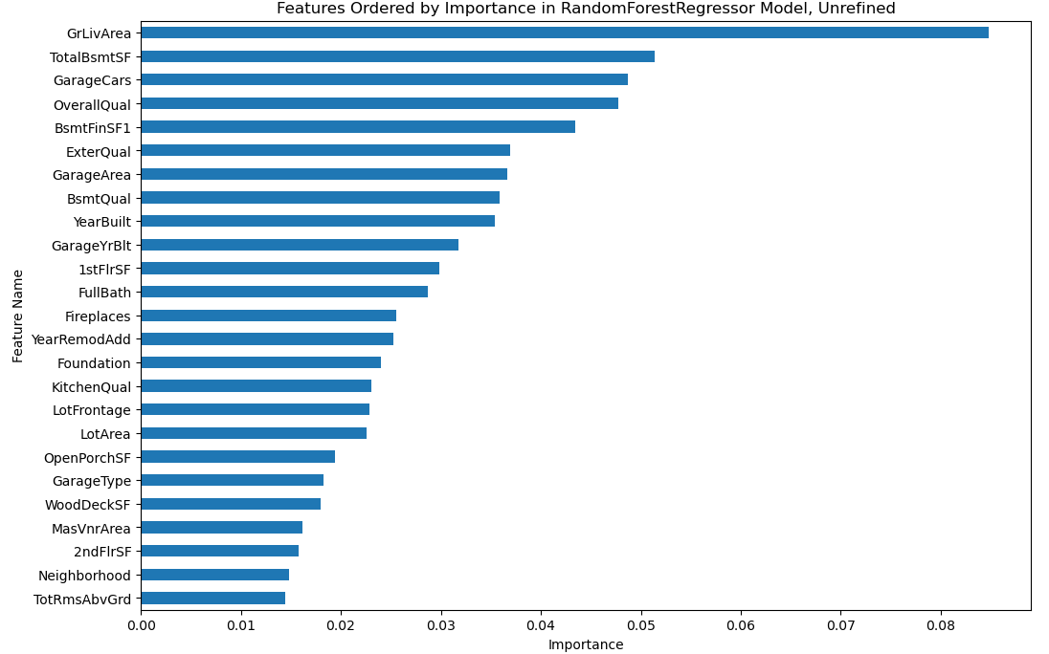
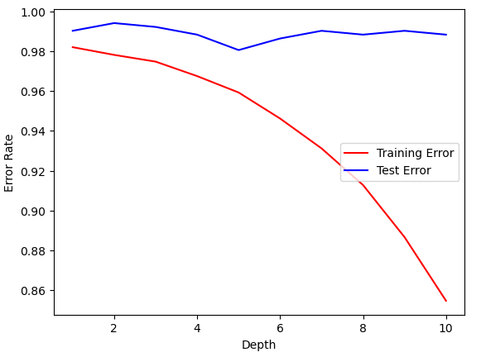
RF: Default
The unrefined RF more represents the correlated heat map, while only vaguely representing the MLR model. For example, OverallCond, the most significant, isn’t even in the Top 25 as a feature.
However, the decision tree tells us that this graph is overfitting at the depth of five. It’s score is also under .90, at .85, which means the model is potentially unreliable.
Notes:
The random forest gives somewhat similar results to the MLR model, with GrLivArea, OverallQual, and TotalBsmtSF all having high importance and high significance. New variables are now more important, such as GarageCars and ExterQual. Note that the MLR model considered GarageYrBlt to be statistically insignificant, yet it is in the top ten here. The decision tree is also highly overfitted, which means low predictive accuracy, and therefore the model needs to be adjusted. The score also at .85, which is lower than the MLR model.

Slide 11

Constructing a Tuned Model
In order to refine the models, we have to take what was discovered from feature importance, as well as statistical significance from the MLR model, and combine the results. This would hopefully create a smaller, more accurate model.
For example, from both models we know GrLivArea is probably important, as are variables like OverallQual, YearBuilt, FirePlaces, BsmtFinSF1, etc..
Some important variables, like 1stFlrSF can also be combined. We can therefore create Total Square Footage (TotalBsmtSF, 1stFlrSF, and 2ndFlrSF), Total Bath (BsmtFullBath, BsmtHalfBath, FullBath, and HalfBath), and Mixed Exterior (Exterior1st, Exterior2nd). This gets rid of issues where the “parts” may not be considered insignificant, but the whole could be.
Finally, we need to adjust the parameters of our model to be more ideal in a form of hyperparameter tuning.
(Image Created Via Stable Diffusion)
Notes:
We know that the MLR suffered from multi-collinearity, which means too many features. We also saw several inconsistencies between the models, whether it be in importance, correlation, or significance. However, the models did tell us, in some ways, a few variables that stuck out in regards to significance and importance. For example, OverallQual is probably important. We can therefore summarize several variables, such as the square footages and the baths, and use hyperparamter tuning in order to get a more refined model.

Slide 12
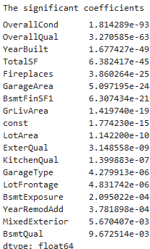
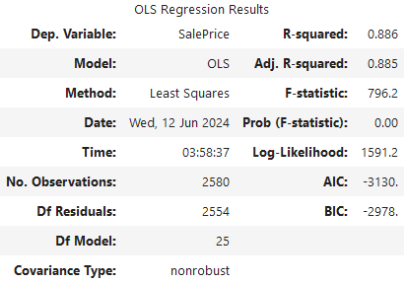
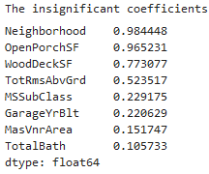
MLR: Tuned
After refining the data, the MLR resulted in a slightly lower score, but a much higher F-statistic. This means it has a stronger correlation, but it is less predictable. We can also see that the results much more align with the importance scale, just based on eyeing it.
Some of the results are also identical to the unrefined MLR model, while our new variable, TotalSF, has now become the most significant numeric variable.
Notes:
Now in the refined model, we have a stronger ratio of significant features, and fewer insignificant features. However, it should also be noted that the R-Squared actually decreased slightly, therefore decreasing its predictive reliability. Our new numeric variable, TotalSF is now the most significant numeric feature, eclipsing GrLivArea, although YearBuilt has ironically become more significant. Despite the decreased R-Squared, the F-Statistic increased by a large margin, which means a stronger correlation.

Slide 13
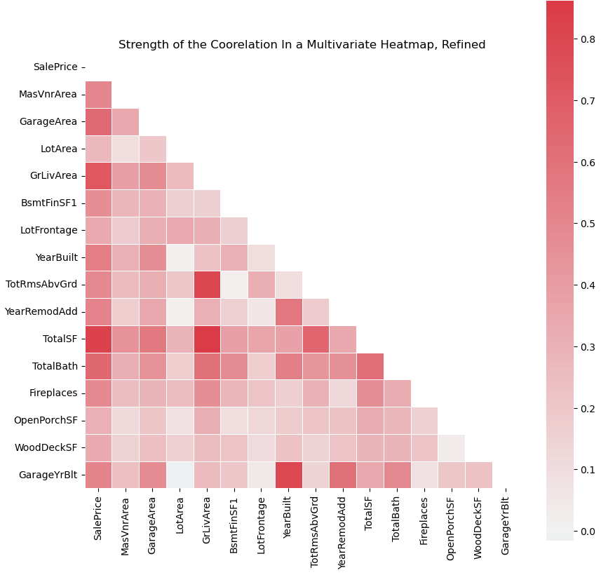
MLR Tuned Correlation Summary
Here, we can see our results compared to the unrefined findings. The improved F-statistic told us there was a stronger correlation, and here we can see nearly every variable is “strong”, even against each other.
Total SF seems to not only have the highest significance, but also the highest inter-correlation across the board, followed by GrLivArea.
Our weakest correlation seems to be LotArea, which was considered statistically significant. This is of note because, GarageYrBlt has an, overall, higher correlation yet was insignificant.
Notes:
Here we can see just how much stronger the correlation is. Across the board, SalePrice has a strong correlation with every other variable. Lot Area is the only variable that is questionable here, a variable considered significant, but not very important.

Slide 14
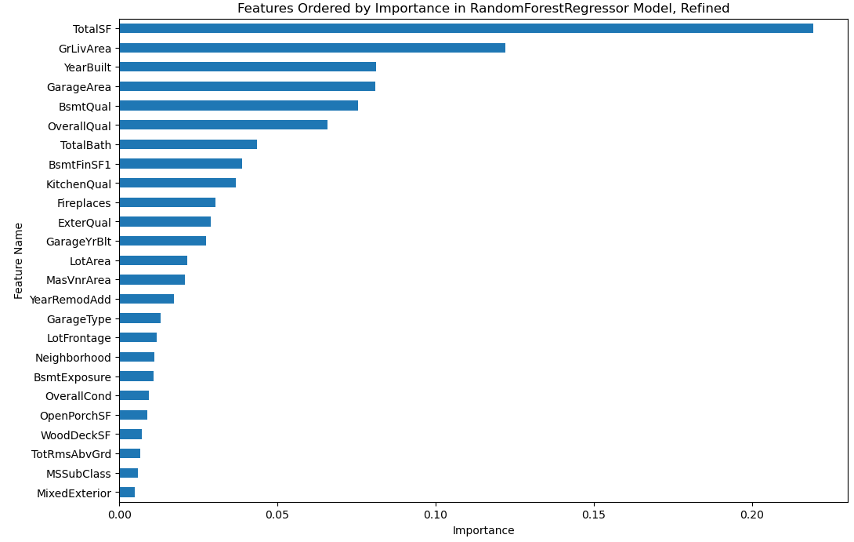
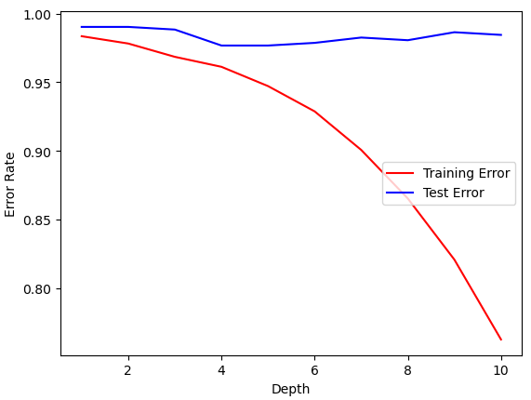
RF: Tuned
The results here are more in-line with the correlations, with TotalSF still being the most important variable. One of the new variables, MixedExterior, is also now the least important variable, yet it was considered more significant than BsmtQual, which is in the top five.
Notes:
The refined random forest more in-line matches the correlations. YearBuilt and GarageArea now have higher importance, but the most notable aspect is that the overall importance has increased for all variables almost throughout. If the feature is important, it can be found “around” at the same level in significance, with a few exceptions like OverallCond and Neighboorhood, which was considered insignificant.

Slide 15
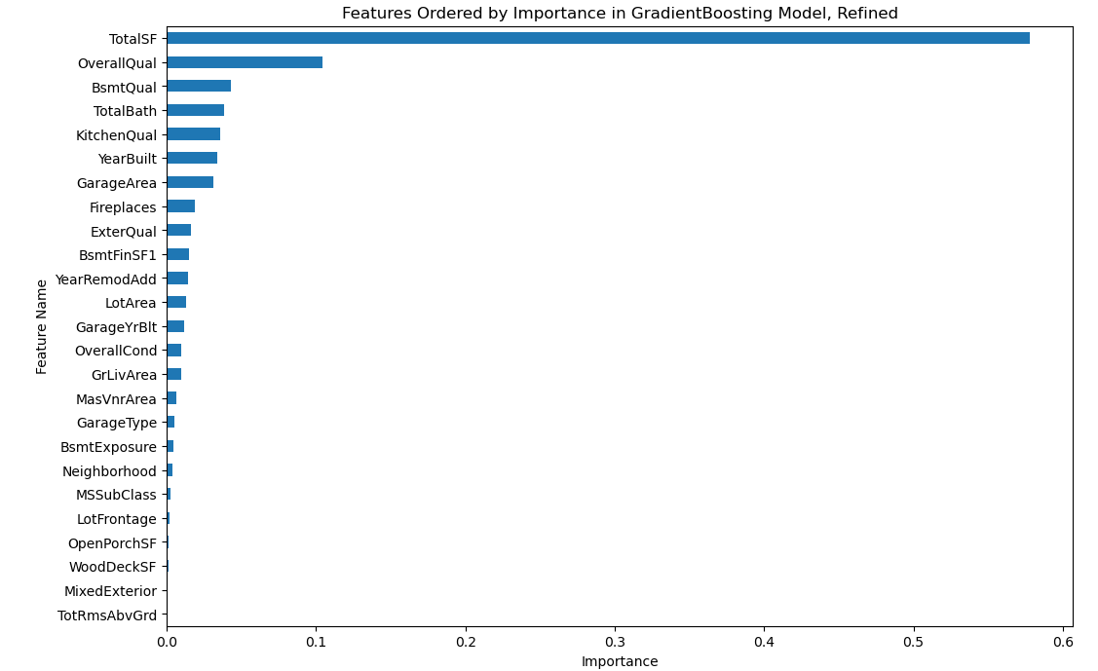
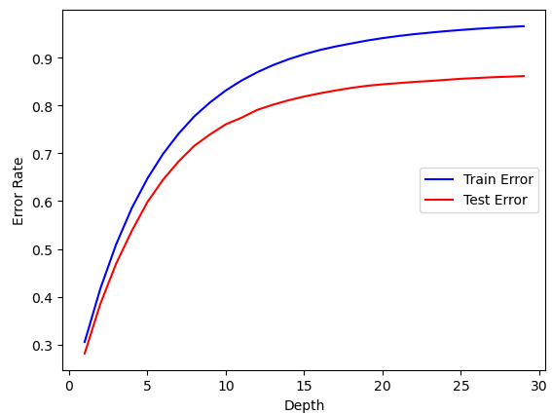
Gradient Boosting: Improving Accuracy
This time overall importance was reduced significantly, although TotalSF is still considered to be the most important factor. Most of the other factors are off by one or two places compared to the RF. This could be explained by the different decision tree, which is now underfitting instead of overfitting.
Gradient boosting, like random forests, combines multiple decision trees to create a model. However, the main difference is that, while random forests are constructed independently, gradient boosting is linear and constructed sequentially, so that it corrects itself.
Because of this self-correction, the expectation, at least, is a collective increase in the score at the risk of increased overfitting.
Notes:
Gradient boosting uses a similar method to random forests, but combines weaker models in order to improve accuracy. It constructs these models sequentially, correcting itself in the process to fix errors. When used here, we can see that TotalSF is still the most important feature, but the overall importance was decreased drastically (the top five were originally around .10). Furthermore, this model’s decision tree has an underfitting issue, where the training error is now higher than the test error. This possibly means not enough data was inputted, or a data leakage issue. The positive side is that this model has the highest score of all models at .96.

Slide 16
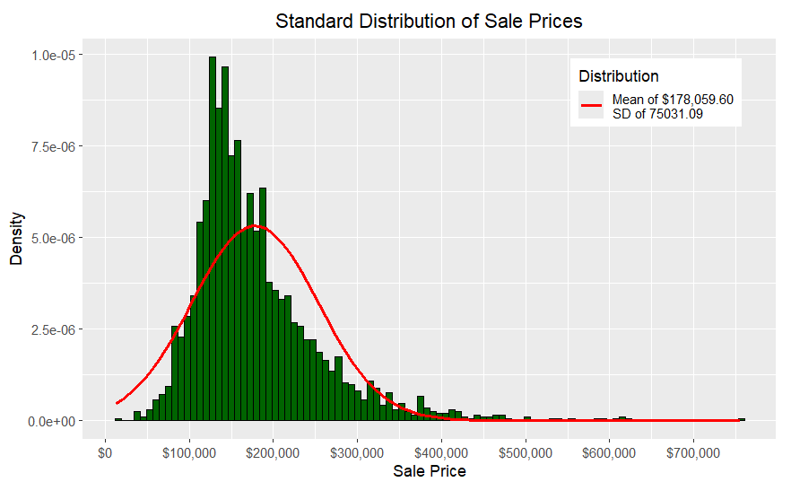
Breaking Down the Results: The Target
To start an analysis, we can look at the target of the models: the Sale Price. Using a standard distribution histogram, we can see that most houses have been sold at around $180,000. This is fairly typical, as most people cannot afford more expensive houses.
However, it should also be kept in mind that there are numerous outliers in the data because of this. In fact, one can even be seen here, with a house being sold at over $700,000. This means every variable, such as TotalSF, TotalBath, etc. would likely distort the data compared to what should be the average.
Notes:
Now that the models have been created, we can look at the actual analysis. For the target itself, Sale Price, when it comes to a standard distribution, we can see that most houses were sold at around $180,000. This makes sense since most people can’t afford expensive houses. We do notice outliers though. These outliers mean outliers for numerous other variables, like anything related to area and square footage, which can distort the data.

Slide 17
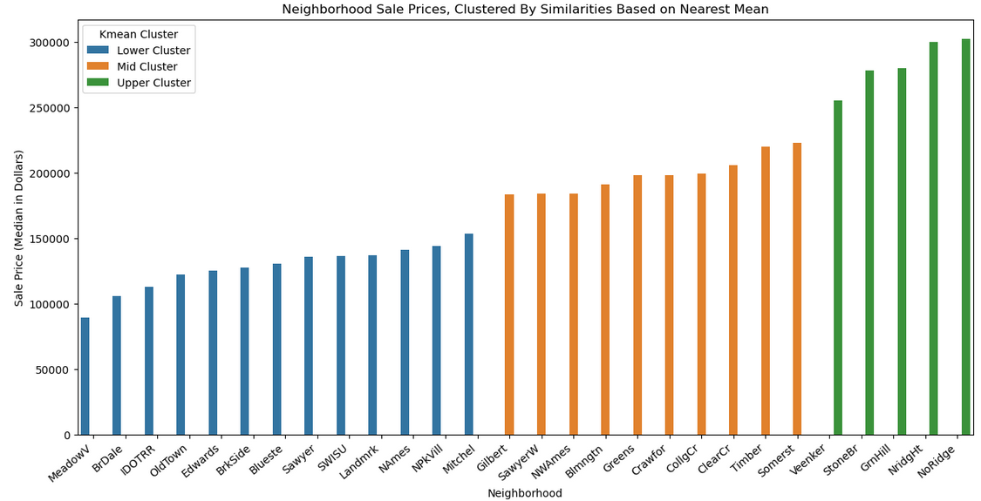
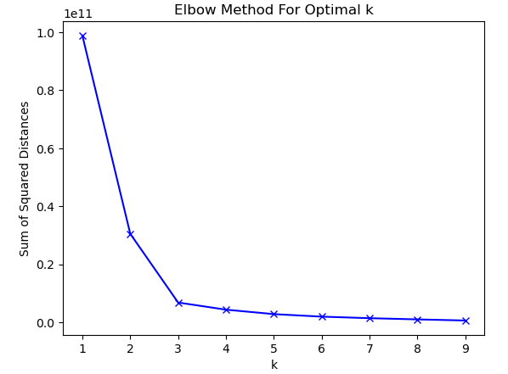
Binning the Neighborhoods
To get a better understanding of which neighborhoods produced the most significant sales, we decided to “bin” them using k-mean clustering. This is a grouping method where each value is grouped together based on similarities according to the nearest mean. To find said mean, one would use the “elbow method”, where the “elbow” is how many groups there are. So, here we can see there are three clusters of neighborhoods based on sale price, with the green cluster possibly being the most valuable.
Notes:
As for the neighborhoods, binning was used to find which neighborhoods had the most “expensive” houses. These were grouped according to similarities based on their mean, the k-mean. So, the most expensive neighborhood might be Northridge Village, while the cheapest might be Meadow Village.

Slide 18
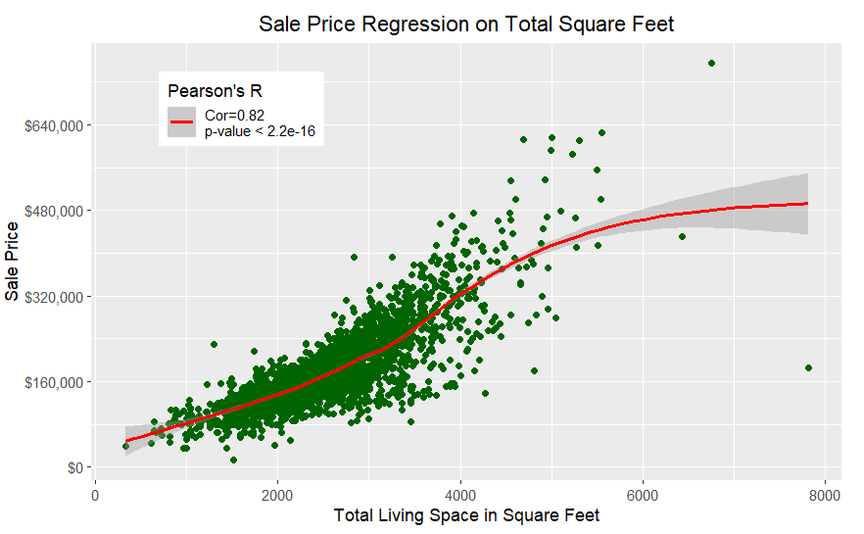
Most Important Feature: Numeric
According to our models, the most important numeric feature is TotalSF, which is the combination of the SF variables. From a weighted regression model (loess), we can see it has a nearing-perfect positive correlation with Sale Price. This aligns with what both models said.
This has only two visible outliers, but they don’t distort the regression line enough to shift it in a meaningful way.
Notes:
The RF determined the most important feature was TotalSF, the combination of all square footage features, and the MLR model said this was also the most significant numeric feature. When running a weighted regression model, the models still stand, with it being a very strong correlation and having a near-linear positive regression.

Slide 19
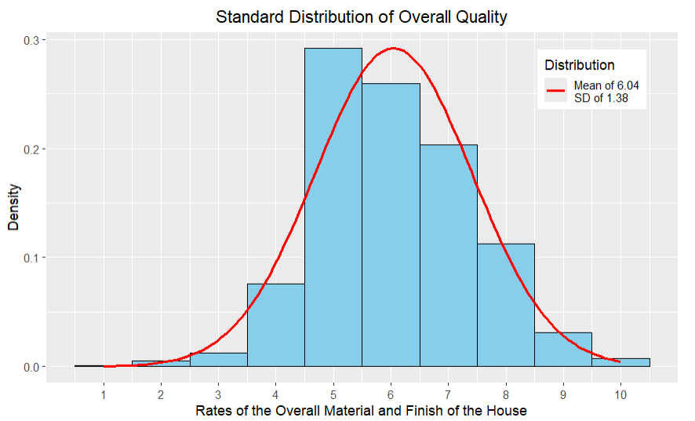
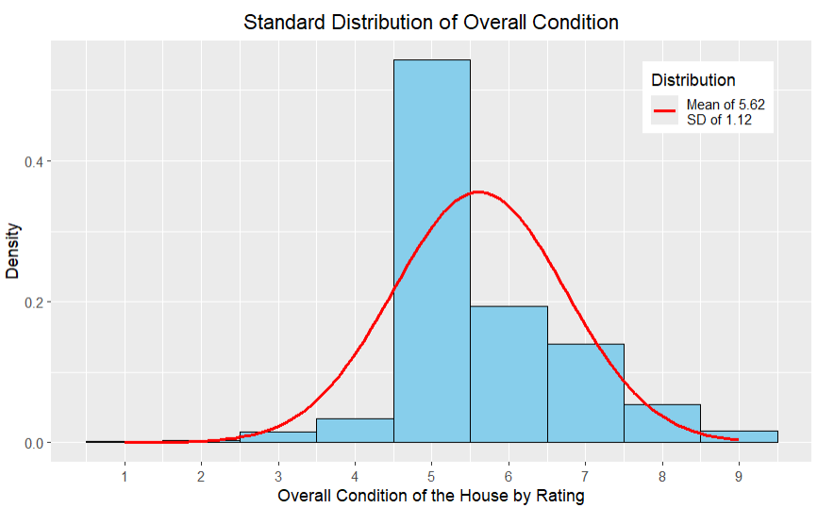
Most Important Feature: Categorical
Our models seem to at least agree that OverallQual is both important and significant, but the random forest model rates OverallCond lower in importance, while the MLR model rates it the highest in significance. The meaning of this will be examined.
Right away, we can see smaller variation in the data. While less variability means less extreme data, this also looks like the regression is going to be more effected by weight.
Notes:
The refined random forest model claimed that overall condition was not very important, despite both MLR models claiming just how significant it was. Yet still, the random forest model said overall quality was the most important categorical feature. We can see here the possible issue when looking at the distribution, where there’s less distribution and variability in the overall condition compared to quality.

Slide 20
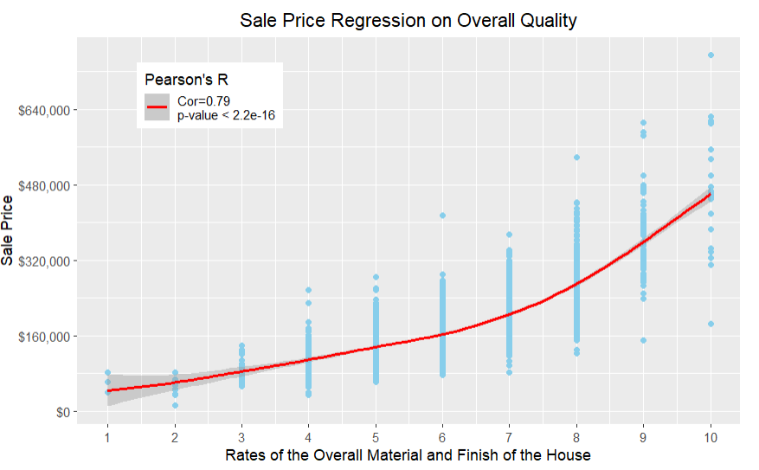
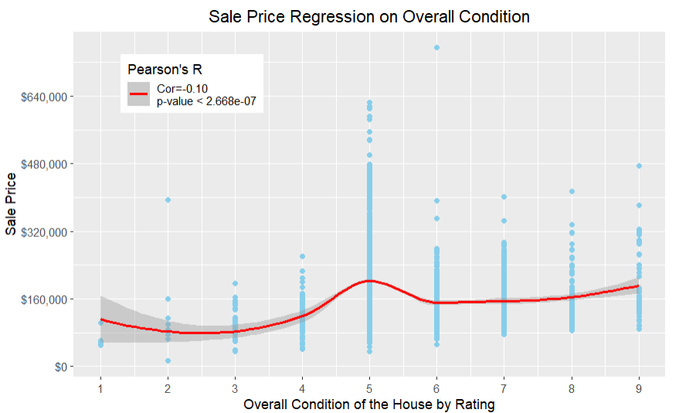
Weighted Regression on Housing Rates
As expected, the OverallQual variable has a much higher correlation than the OverallCond variable. So much so that OverallCond goes into the negative. This may explain why OverallQual is so much higher in the RF model. As shown in the previous graphs, the smaller variability in OverallCond caused so much focus on one rating (5) that the loess regression produced a “hump” at that point.
Notes:
This lack of variability is then shown here, how the focus on the rating of five led to an immensely weak correlation for overall condition, while overall quality has a much stronger correlation. We can also see that, when taken individually, the pearson’s R significance for condition is lower than quality.

Slide 21
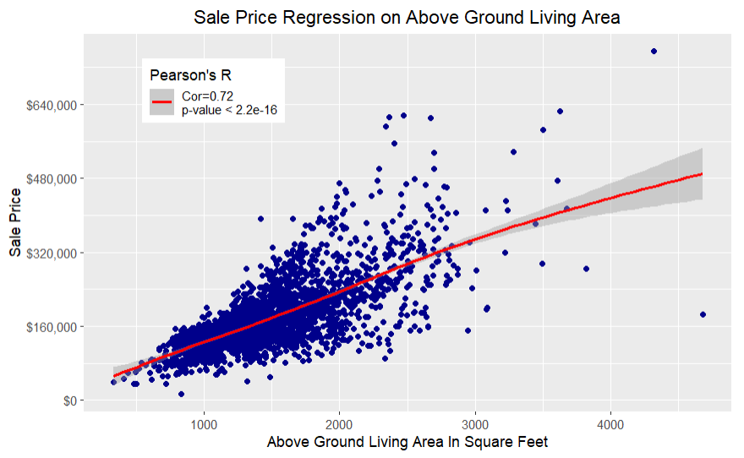
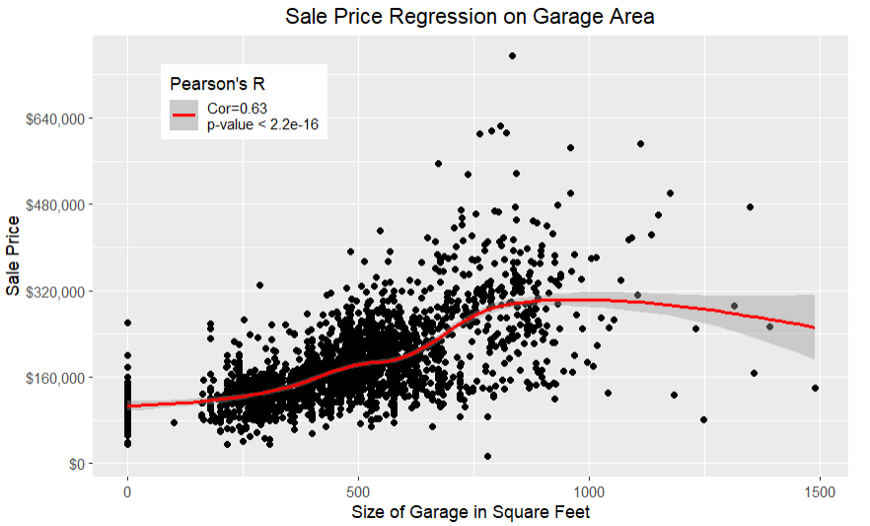
Other Highly “Important” Features
The other most important features, according to the RF model, are similar to the TotalSF. They are highly correlated, along with being statistically significant. GarageArea was actually considered one of the most significant factors, according to the MLR model, but here we see GrLivArea coinciding with linearity more. GarageArea also has a numerous amount of “0” values, presumably those houses that do not have garages, which could distort the data.
Notes:
Here are some other highly significant and important features mentioned in the models. Their correlation strengths are both high, although as the strength decreases, the linearity seems to be affected as well, along with the weighted regression line.

Slide 22
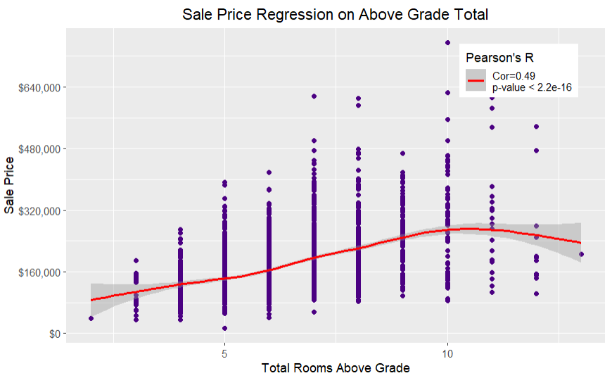
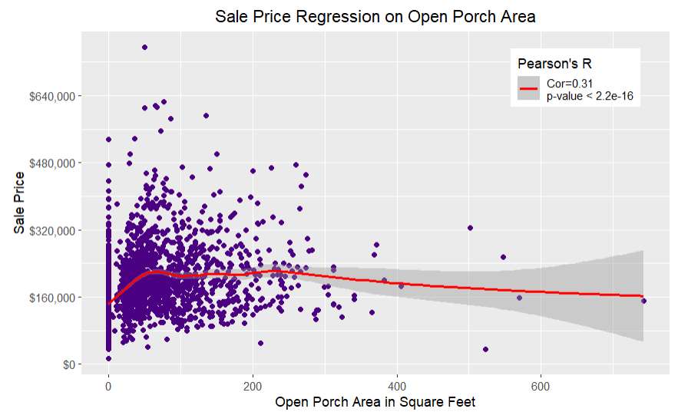
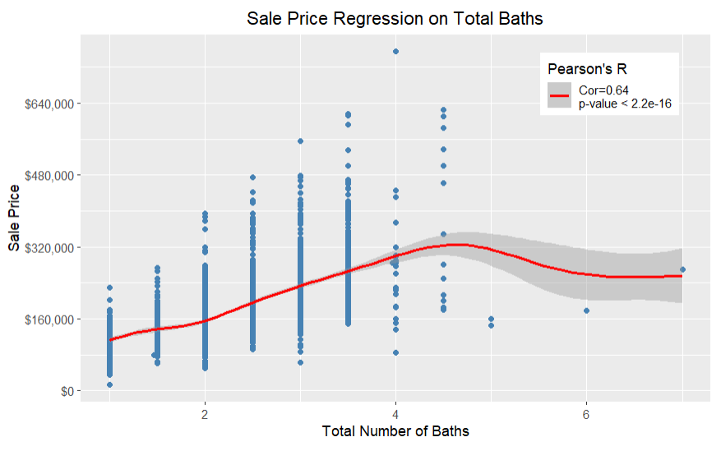
The Weaker Correlations
The RF said that TotRmsAbvGrd was the lowest numerical factor by importance. OpenPorchSF not only had low importance, but it was the numerically most insignificant factor. TotalBath, one of the new variables, was considered important, but insignificant. There are inconsistencies here, such as how TotRmsAbvGrd has a higher correlation than LotArea (0.27), yet is less important. In the MLR OpenPorchSF and TotalBath were insignificant, but when analyzed by themselves, they’re significant.
Notes:
There are inconsistencies when examining the weaker features. For example, Total Rooms Above Ground, the weakest feature by importance, has a higher correlation than LotArea, and was considered significant by itself. TotalBaths and OpenPorchSF were also significant by themselves, when in the MLR they were insignificant. TotalBath also has higher correlation than GarageArea, yet is considered less important.

Slide 23
Summary: The Models
Overall, the models give us mixed results. The refined models increased the score with the exception of the MLR model, although the unrefined MLR model has the unique problem of multi-collinearity.
The refined models focus-in on the strength of the relationships, while still leaving room for similarity between the models (such as how TotalSF is the most important feature, and how OveralCond is the most significant feature in both models).
Yet still, there are many discrepancies to be made, such as how TotalBath is one of the more important factors, yet the MLR model considered it insignificant. The GB model also, despite having the highest score, had a severe underfitting issue instead of overfitting. Its features were also mixed compared to the refined RF, having a lowered importance overall.
While immediate overfitting is apparent for both the unrefined and refined RF models, it should also be noted that the unrefined BIC is higher than the refined model, while having a lower AIC. This gives two different answers to the question of “is it a better-fit model”.
MLR Default Score | MLR Default Score | RF Default Score | RF Refined Score | GB Refined Score
0.909 | 0.886 | 0.850 | 0.903 | 0.960
Notes:
The models give mixed results, where at multiple parts they are contradicting each other. The unrefined models have the issue of multi-collinearity, and consider some features important yet insignificant. The refined models highlight the strength of the relationships, while also still somewhat mirroring the unrefined models. Notably the scores for the refined models are higher for the RF and gradient boosting, but lower for the MLR. There are also many discrepancies, such as how YearBuilt is actually more important in the refined RF model than the unrefined model, and how the AIC is lower in the unrefined model, yet has a higher BIC. This gives a mixed answer to the “better-fit” question.

Slide 24
Summary: The Data
The refined models can be used to pick out the features that have A) the strongest correlations and B) those that have the highest statistical significance. We can then test these features by themselves against the unrefined and refined models to see if the assumption still holds true.
It would appear that TotalSF in all cases has the strongest correlation. GrLivArea was considered the second most important feature, but its strength was outmatched by OverallQual, which was consistently one of the features with the highest statistical significance.
We noted that the weakest relationships had inconsistent results with the models, such as how certain ones were significant in one area or more/less important. This was also reflected when tested alone.
OverallCond notably had a very low correlation, even though it was one of the most statistically significant relationships according to the models. However, when tested alone in Pearson’s r (note the MLR were Ordinary Least Squares models) it actually had a lower significance than the other relationships.
Notes:
When it comes to the data based on the models, as expected, the total square footage is the strongest, most significant feature. This was followed by above ground living area and the overall quality. Overall condition was considered extremely significant in the MLR model, but when actually examined the relationship was poor. Other relationships had inconsistencies with significances and their relationship strengths when tested alone.

Slide 25
Areas For Improvement
Feature Selection: We refined the results arbitrarily based on the feature importance combined with the statistical significance. Judging by what was mentioned with “best score”, the slightest changes with what was selected could have drastically affected the results.
Effects Size: One of the notable problems with the models was that the correlations went against the significance. A feature can be statistically significant, but not statistically meaningful. A model should, ideally, reflect both.
Outliers and Missing Values: Most of the missing values were replaced with “mean”, unless context said otherwise. This is not always wise and can distort the data. Furthermore, no outliers were removed. This can severely effect linearity when it comes to a probability plot. This is noticible in several of the graphs.
Other Models: Other models can be used to address various issues. This includes classification modeling (regressors were used), lasso regression, gridsearch, and feature engineering. Additionally the parameters can be adjusted
Modeling
Data
1
Predictive Reliability: The score for all models was lower than desired. Ideally, they should all be above .90
1
2
2
3
3
Normalization: Data can be normalized to reduce problems with overfitting.
Notes:
There are many areas that can be improved. In regards to the models themselves, the predictive reliability was low. This can be increased using various methods related to other areas for improvement, such as a lasso regression for feature selection. Another problem frequently brought up is how the models were inconsistent. A feature can be statistically significant, but not statistically meaningful. A model should reflect both, and the requirement of swapping back and forth is not ideal. Obviously other models can be used, such as gridsearching and gradient boosting. Additionally, the refined models could, instead, be based on the gradient boosting instead of the random forest, although the overfitting issue should still need to be solved, as with the base model.
In regards to the data, feature selection can be adjusted, which previously had a notable change on the outcome to begin with. We could also change how we deal with outliers and missing values, where it was pointed out just how much outliers could affect the weighted regressions. All numeric data can also be normalized, which potentially allows for better, faster, and more accurate results.

Slide 26
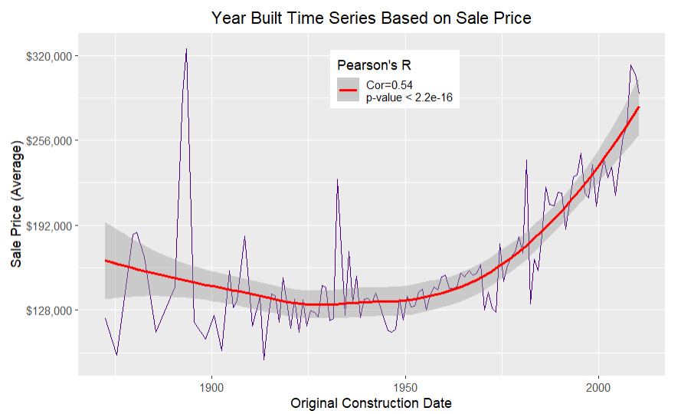
Questions? Comments? Suggestions?
YearBuilt was in the top five for the most important factors, and was notably also statistically significant according to the MLR model.
Notes:
YearBuilt was a feature that changed positions throughout in the unrefined and refined models. It was frequently mentioned as significant and important, with it being considered more important in the refined model than the unrefined model.

